Slide 1
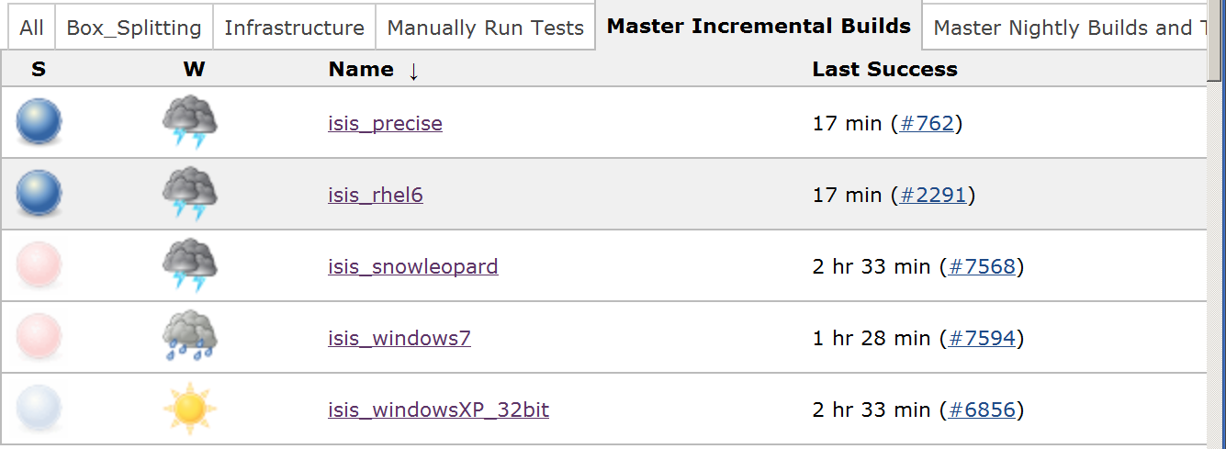
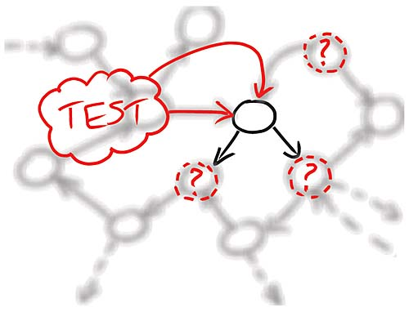
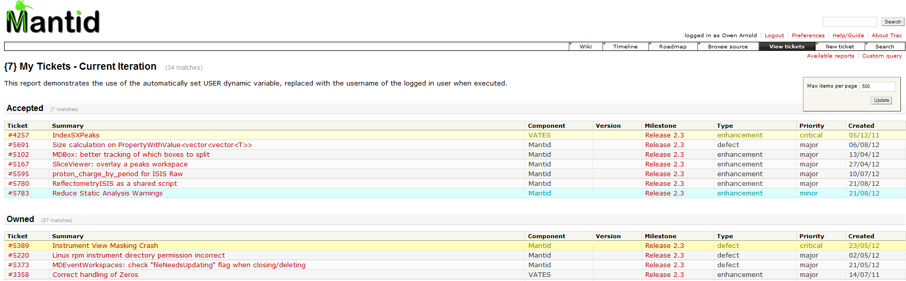
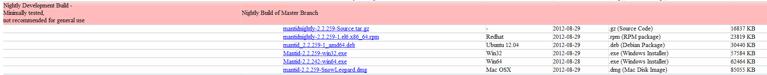
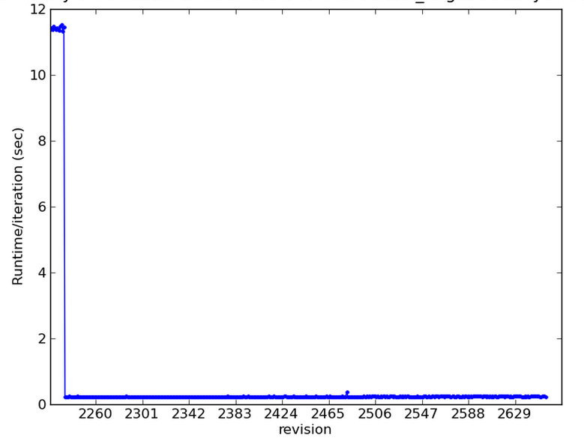
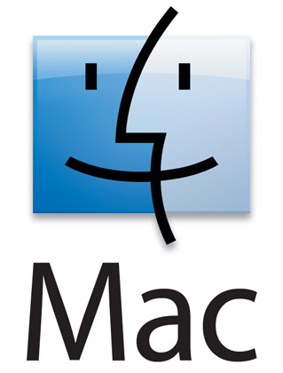

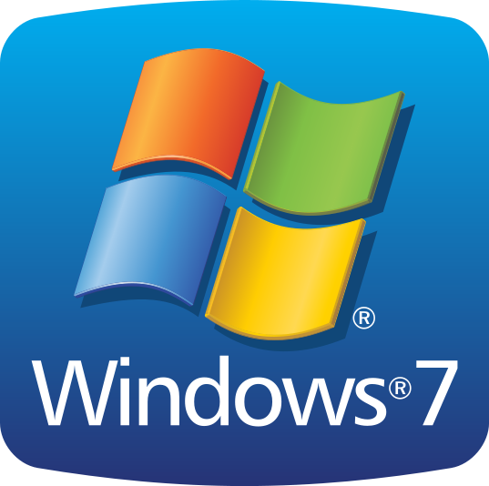


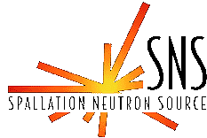
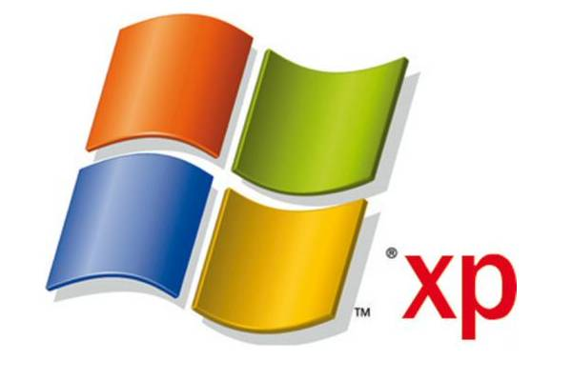
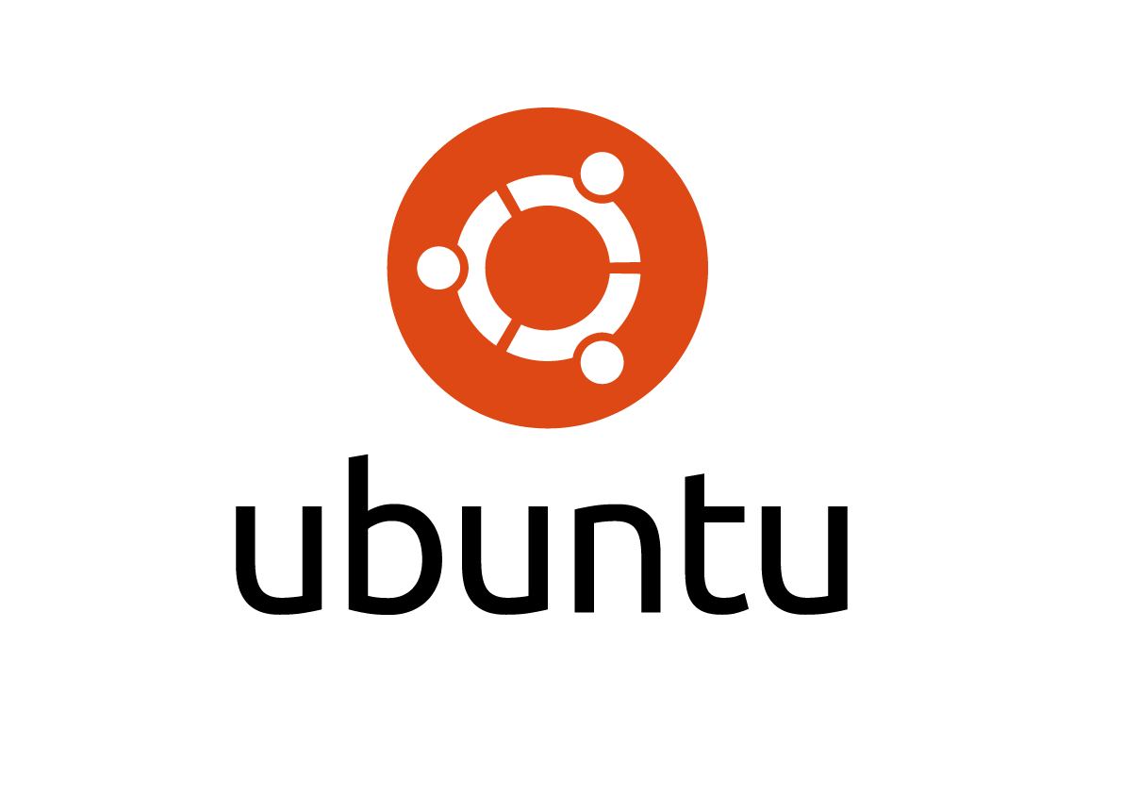
Continuous Build, Test and Deployment – the Mantid Model
Owen Arnold
Tessella, 26 The Quadrant, Abindon Science Park, Abingdon, Oxfordshire, OX14 3YS
Background Mantid has become a world-leading framework for neutron and muon reduction and data analysis. As such, it is critical that the software works consistently, rapidly and provides the same result upon every execution. However, Mantid is also an iterative development with frequent releases targeting multiple platforms. The codebase is naturally large, supporting many complex calculations across more than 1x10⁶ lines of code. A team of 20 developers situated at two scientific sites, 4000 miles apart, simultaneously contribute towards this evolving codebase. Approximately every two months, the Mantid project completes the high-level iterative cycle. Continuous integration allows us to automate many phases of this iterative cycle. This frees the development team to process the issue backlog, yielding new and exciting features. Mantid high-level. Iterative cycle. Tracking Issues Mantid supports 37 instruments across 3 scientific sites. The project receives a large number of enhancement requests as well as defect reports. The scientific steering committee provide a level of filtering for these enhancements and also lay-down a strategic direction which sets the priority of these issues. All work to be undertaken is stored in our Trac, online ticketing system. Issues are given a priority and assigned to individual developers. Developers cannot submit changes to the codebase unless it contains a tag cross-reference to at least one ticket from Trac. View of outstanding tickets through Trac. Distributed Version Control Version control is now widely practiced. Until recently the project was successfully run using SVN. However, as the project grew, both in terms of the team size and the complexity, centralized version control became cumbersome. Git is now used, with public, remote repositories hoted on GitHub. The ability to generate branches easily and work offline, where the major drivers. Committing to a local repository before pushing changesets has reduced the load on the build servers and generally lead to smaller explicit individual commits. | Test Driven Development Test driven development (TDD) is a development methodology, which generally leads to better quality code with, increased cohesion and better decoupling. We find that the bi-product of the process, the test suite, is usually more comprehensive and has a better ability to pinpoint failure than test suites generated post-development TDD development cycle. The Mantid project utilizes the Google GMock Mocking framework. Mocking is a very powerful technique, which is highly complementary to the TDD process. Mocking interfaces allows tests to be isolated and allows TDD to proceed against parts of the codebase that don’t yet exist. We find that a combination of Mocking and TDD, rather than TDD alone, leads to tests suites with higher coverage, better reporting and much faster execution times than is otherwise possible. Striving for mocking as part of the TDD process naturally leads to dependency injection and low coupling in the resultant code. Isolating the test component using Mocking. Continuous Integration Server Continuous integration is ultimately a quality control methodology that continuously measures the software product. Fault and failure detection therefore is achieved at the earliest possible time and it is therefore significantly less time consuming or expensive to fix. The Mantid project, continuous integration master server, hosts Jenkins, an open source derivative of Hudson. The master server contains a list of connected ‘Executor’ hardware as well as a list of virtual Jobs. When a job is indicates that it is pending, Jenkins finds an appropriate executor and collates the results after the job completes. Our setup is duplicated at each facility, so that any server outages will cause minimum disruption to normal working. | Overview of Jenkins Master connected to Slave Executors. Jobs on each are indicated. Example Jenkins dash-board indicating the status of the incremental jobs. Continuous Integration Jobs For each of our target platforms, there is an equivalent incremental job that polls Git for any change to the codebase. Any change triggers a build followed by the execution of all the Unit test suites. If those pass successfully, the build is packaged and archived. Every incremental job has an associated clean job. These are executed every 24 hours. Again ,unit tests are run and if these succeed the binaries are packaged. As an additional step, the packaged builds are then automatically deployed on to their target platform and a series of system tests are executed on the deployed system. If the system tests pass then the packaged binaries are copied onto the Mantid download site in the ‘nightly-builds’. Nightly builds generated by clean jobs Other jobs are not run on each platform. Examples of these are the static analysis and performance test Jobs. Static analysis tools check the code against style rules and look for duplicates. Performance tests check execution time for specific tests against historical data. Example performance test report.
RHEL6
Slave
Incremental Job
Clean Job (queued)
Windows 7 Slave
Clean (feature branch) Job
Ubuntu Slave
Performance Test Job
CppCheck Job
Write a failing test
Make the test pass
Refactor
Backlog
Development
Testing
Release
End User and Scientist Requests
Scientific Steering Comittee
Acknowledgements

